Slide 1

Asymptotic Notations
Presented by:
Elizer Ponio Jr.
Department of Computer Science
College of Computing and Information Technologies

Slide 2
Outline
What is an Asymptotic Notation?
Types of Asymptotic Notations

Slide 3
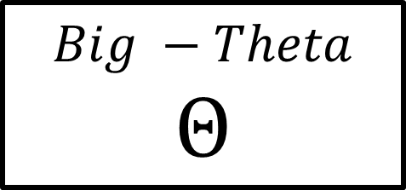
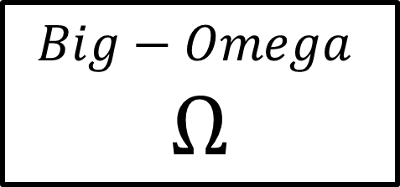
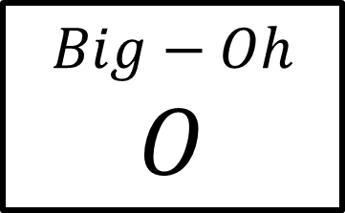
Asymptotic Notations
Asymptotic notations are the mathematical notations used to describe the running time of an algorithm when the input tends towards a particular value or a limiting value.
There are mainly three asymptotic notations:
$$Big−Oh$$
$$O$$
$$Big−Omega$$
$$Ω$$
$$Big −Theta$$
$$Θ$$

Slide 4
Big-O Notation (O-notation)
Big-O notation represents the upper bound of the running time of an algorithm. Thus, it gives the worst-case complexity of an algorithm.

Slide 5



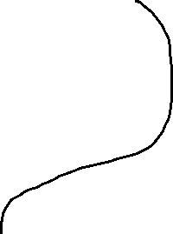
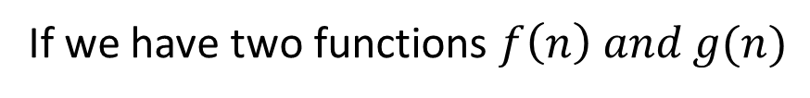
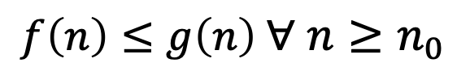


Big-O Notation (O-notation)
If we have two functions $f\left(n\right) and g(n)$
$$f\left(n\right)=2n+3$$
$$g\left(n\right)=2n^{2}+3n^{2}$$
$f\left(n\right)≤g\left(n\right)$ $∀ n≥n_{0}$
$$2n+3≤2n^{2}+3n^{2}$$
$$2n+3≤5n^{2}$$
Upper Bound
$$1<\log_{2}n< \sqrt{n}<n<n \log_{2}n< n^{2}<n^{3}…<2^{n}< 3^{n}< …<n^{n}$$

Slide 6
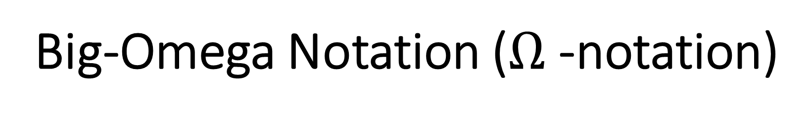
Big-Omega Notation ($Ω$-notation)
Big-Omega notation represents the lower bound of the running time of an algorithm. Thus, it gives the best complexity of an algorithm.

Slide 7


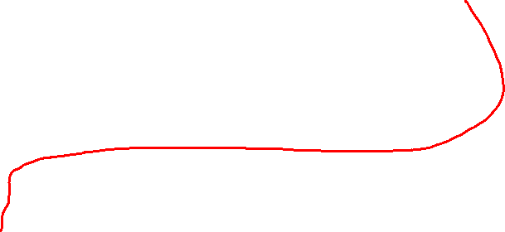


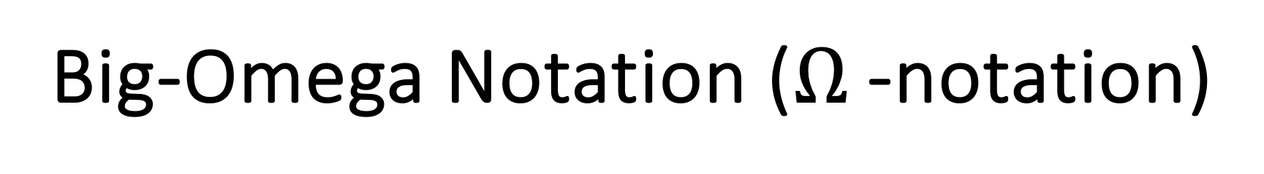
Big-Omega Notation ($Ω$-notation)
If we have two functions $f\left(n\right) and g(n)$
$$f\left(n\right)=2n+3$$
$$g\left(n\right)=\log_{2}n+1$$
$$f\left(n\right)≥g\left(n\right) ∀ n≥n_{0}$$
$$2n+3≥\log_{2}n+1$$
Lower Bound
$$1<\log_{2}n< \sqrt{n}<n<n \log_{2}n< n^{2}<n^{3}…<2^{n}< 3^{n}< …<n^{n}$$

Slide 8
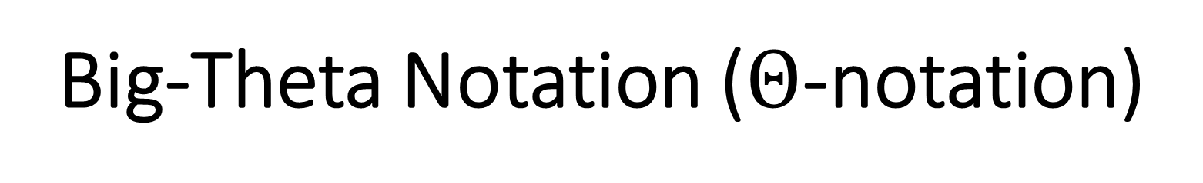
Big-Theta Notation ($Θ$-notation)
Big-Theta notation represents the upper and lower bound of the running time of an algorithm. Thus, it gives the average-case complexity of an algorithm.

Slide 9


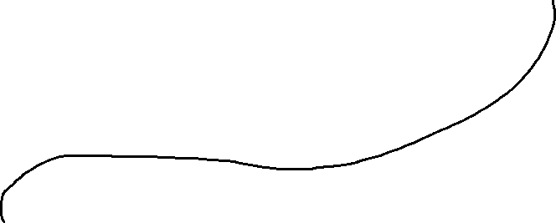
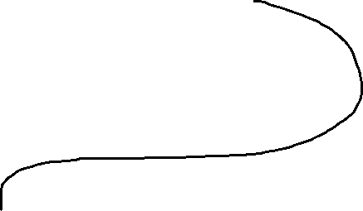


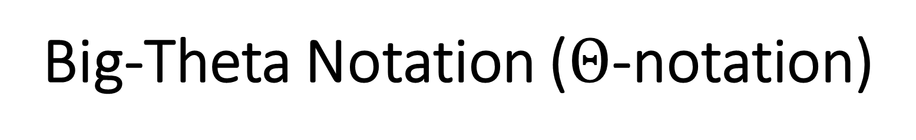

Big-Theta Notation ($Θ$-notation)
If we have three functions $f\left(n\right) and g\left(n\right) and h(n)$
$$f\left(n\right)=2n+3$$
$$g\left(n\right)=1×n$$
$$h\left(n\right)=5×n$$
$$g\left(n\right)≤f\left(n\right)≤h(n)$$
$$1×n≤2n+3≤5×n$$
Average bound
$$1<\log_{2}n< \sqrt{n}<n<n \log_{2}n< n^{2}<n^{3}…<2^{n}< 3^{n}< …<n^{n}$$

